Slide 1
Projet Machine Learning
LACHAUSSEE QUENTIN
14-01-2022
Notes:
Bonjour à tous et à toute, déjà merci d'être présent pour ma soutenance,
Donc je m'appelle Quentin LACHAUSSEE, je viens d'un DUT Statistiques et informatique décisionnelle
Et aujourd'hui je travaille en tant qu’alternant chez MESEA depuis près d'un an et demi maintenant
Et aujourd'hui je vais vous parler de mon entreprise et comment mon projet a pu améliorer les conditions de travail de mes collègues.
Donc, dites-moi,
Est-ce que vous saviez que vous pouviez faire le trajet entre Tours et Bordeaux en moins d'une 1 heure?
Et bien ça, c'est possible en train ! grâce à la ligne à grande vitesse SEA,
Mais pour en arriver à cette prouesse au niveau national, il y a toute une histoire derrière, des points positifs comme des points négatifs à améliorer, un véritable background.

Slide 2
Sommaire
I- Algorithme Perceptron Simple
II- Apprentissage Widrow : ensemble Test 1 / Test 2
III- Mise en place d’un perceptron Multicouche
IV- Apprentissage Multicouches
V- Volet Chargement des descripteurs
VI- Classification par Full Connected
VII- Classification par Deep
Notes:
So, about my company, in 2008, the French railway network launched a call for the construction of a new high-speed line between Tours and Bordeaux.
----------------------------
In 2011, the company LISEA took part in this concession contract for a period of 50 years.
----------------------------
Then, LISEA confided the design and construction of the LGV to the group COSEA, C like Constructor.
----------------------------
Since the end of the construction in July 2017, the group MESEA is responsible of the maintenance, M like Maintenance, of this LGV of the South Europe Atlantic.
----------------------------
So, MESEA is the private part of a public-private partnership with the SNCF, it has 3 maintenance bases in Clérac, Villognon, Nouâtre and one secondary base in Poitiers to ensure the safe running of trains 24/7.

Slide 3
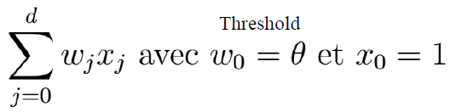
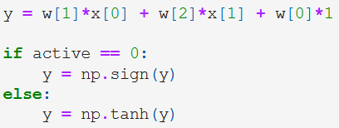
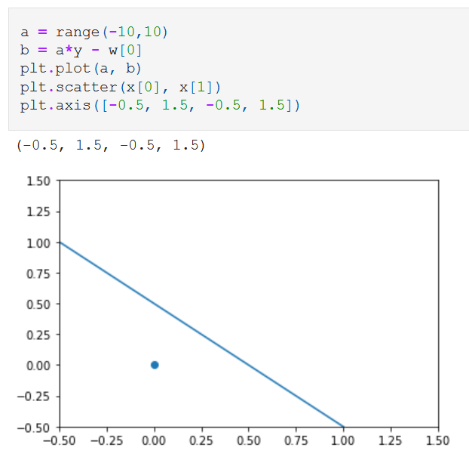
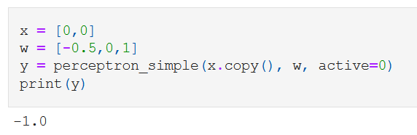
I - Algorithme Perceptron Simple
Pour développer le perceptron simple, j’ai utilisé cette formule :
La figure individu / frontière suivante montre que dans le cas du « OU »,
Dans le cas du « OU », on utilise le « sign »
On obtient bien « -1 »
les points en dessous de la ligne auront un résultat égal à « -1 », et « 1 » pour les points au dessus
Notes:
Today, MESEA has around 200 employees, which can be divided into an operational and a functional branch.
The functional part concerns the production support activities, such as the Industrial Department, the Performance Department, the Quality, Safety and Environment Department etc.
----------------------------
The operational part is responsible of the line maintain, covering all the areas of a high-speed line.
In the world of railway maintenance, there are many different areas but we can reduce them to 4 major sectors: The track, the switch, the signalling and the energy.
The railway tracking is a runway for the trains. A train cannot driving on the road, that’s why the track allows to give a trajectory and a stability to the train.
The railway switching allows to give a direction to the train, to direct it, on one track or another.
The railway signalling can be defined as all the systems designed to control the train traffic in safety.

Slide 4
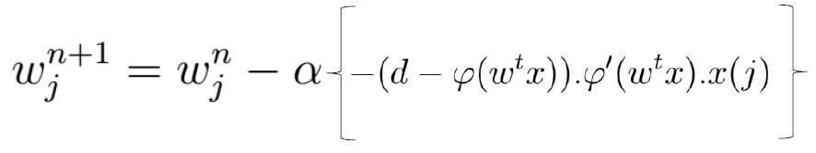
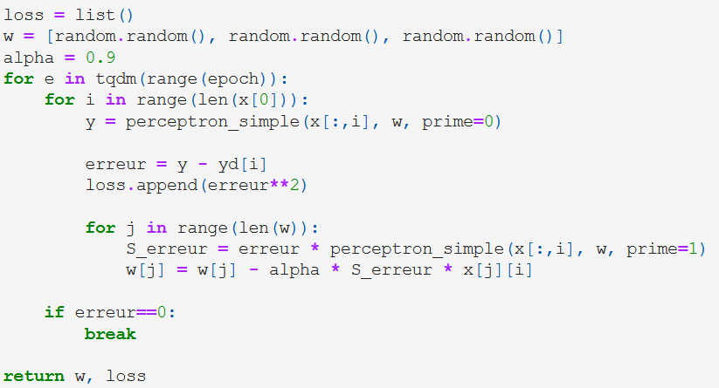
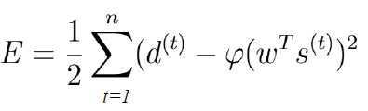
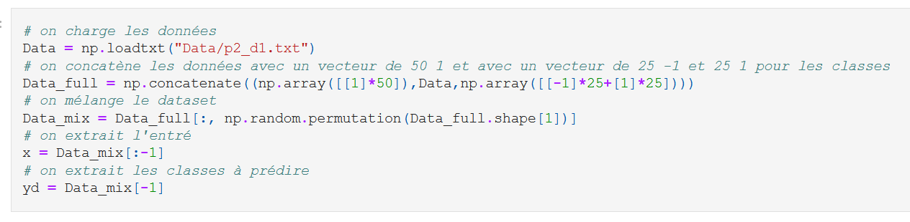
II - Apprentissage Widrow
Pour développer l’apprentissage Widrow, j’ai utilisé cette formule :
Et de celle-ci pour l’erreur :
Et pour tester l’apprentissage, le processus est le suivant :
Notes:
Today, MESEA has around 200 employees, which can be divided into an operational and a functional branch.
The functional part concerns the production support activities, such as the Industrial Department, the Performance Department, the Quality, Safety and Environment Department etc.
----------------------------
The operational part is responsible of the line maintain, covering all the areas of a high-speed line.
In the world of railway maintenance, there are many different areas but we can reduce them to 4 major sectors: The track, the switch, the signalling and the energy.
The railway tracking is a runway for the trains. A train cannot driving on the road, that’s why the track allows to give a trajectory and a stability to the train.
The railway switching allows to give a direction to the train, to direct it, on one track or another.
The railway signalling can be defined as all the systems designed to control the train traffic in safety.

Slide 5
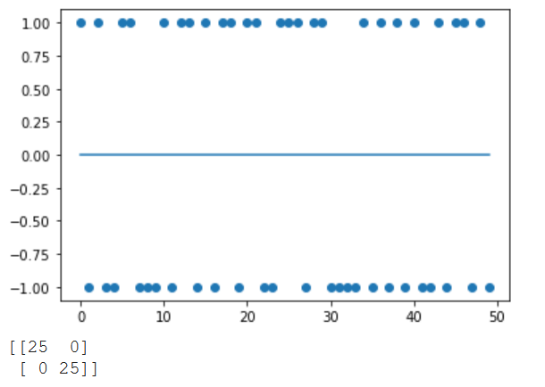
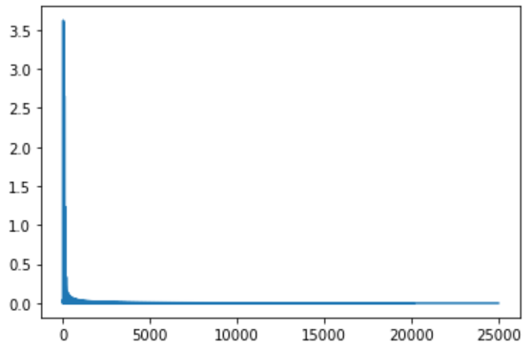
II - Apprentissage Widrow – Test 1
Le graphique des prédictions
Les prédictions sont excellentes
La matrice de confusion affiche un résultat parfait
On voit bien que la courbe d'erreur est de plus en plus faible et converge vers 0
Après quelques tests avec des initialisations différentes :
Le nombre d’epoch devient de moins en moins significatif à partir d’environ 2500
La valeur du batch_size influe sur la longueur de la courbe, mais diminue l’erreur plus rapidement
La matrice de confusion
La courbe d’erreur
Notes:
Today, MESEA has around 200 employees, which can be divided into an operational and a functional branch.
The functional part concerns the production support activities, such as the Industrial Department, the Performance Department, the Quality, Safety and Environment Department etc.
----------------------------
The operational part is responsible of the line maintain, covering all the areas of a high-speed line.
In the world of railway maintenance, there are many different areas but we can reduce them to 4 major sectors: The track, the switch, the signalling and the energy.
The railway tracking is a runway for the trains. A train cannot driving on the road, that’s why the track allows to give a trajectory and a stability to the train.
The railway switching allows to give a direction to the train, to direct it, on one track or another.
The railway signalling can be defined as all the systems designed to control the train traffic in safety.

Slide 6
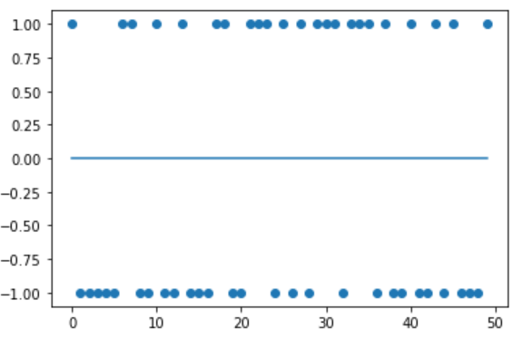
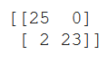
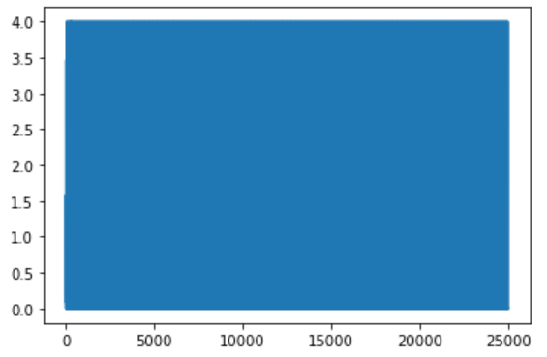
II - Apprentissage Widrow – Test 2
Le graphique des prédictions
Les prédictions sont très bonnes
La matrice de confusion affiche un résultat quasiment parfait
En revanche la courbe d’erreur n’affiche pas de convergence vers 0
Après quelques tests avec des initialisations différentes, les résultats ne sont pas meilleurs
-> Les données n'ont sûrement pas assez de liens avec leur classe
La matrice de confusion
La courbe d’erreur
Notes:
Today, MESEA has around 200 employees, which can be divided into an operational and a functional branch.
The functional part concerns the production support activities, such as the Industrial Department, the Performance Department, the Quality, Safety and Environment Department etc.
----------------------------
The operational part is responsible of the line maintain, covering all the areas of a high-speed line.
In the world of railway maintenance, there are many different areas but we can reduce them to 4 major sectors: The track, the switch, the signalling and the energy.
The railway tracking is a runway for the trains. A train cannot driving on the road, that’s why the track allows to give a trajectory and a stability to the train.
The railway switching allows to give a direction to the train, to direct it, on one track or another.
The railway signalling can be defined as all the systems designed to control the train traffic in safety.

Slide 7
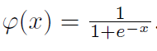
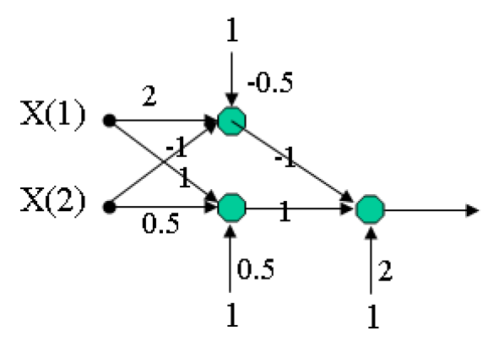
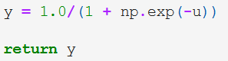
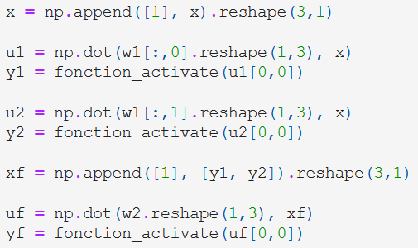
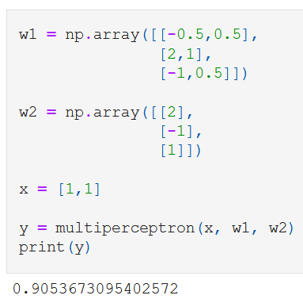
III - Mise en place d’un perceptron Multicouche
Pour développer le perceptron multicouche, j’ai utilisé cette formule :
Couche cachée :
1er neurone : -0.5 x 1 + 2 x 1 + -1 x 1 = 0.5
-> donc 1/ (1 + e^(-0.5)) = 0.62
2e neurone : 0.5 x 1 + 1 x 1 + 0.5 x 1 = 2
-> donc 1/ (1 + e^(-2)) = 0.88
Couche de sortie :
1er neurone : 2 x 1 + -1 x 0.62 + 1 x 0.88 = 2.26
-> donc 1/ (1 + e^(-2.26)) = 0.91
Notes:
Today, MESEA has around 200 employees, which can be divided into an operational and a functional branch.
The functional part concerns the production support activities, such as the Industrial Department, the Performance Department, the Quality, Safety and Environment Department etc.
----------------------------
The operational part is responsible of the line maintain, covering all the areas of a high-speed line.
In the world of railway maintenance, there are many different areas but we can reduce them to 4 major sectors: The track, the switch, the signalling and the energy.
The railway tracking is a runway for the trains. A train cannot driving on the road, that’s why the track allows to give a trajectory and a stability to the train.
The railway switching allows to give a direction to the train, to direct it, on one track or another.
The railway signalling can be defined as all the systems designed to control the train traffic in safety.

Slide 8
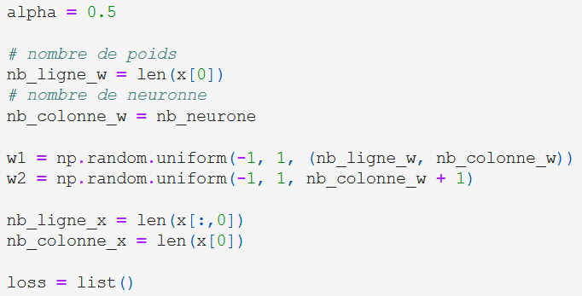
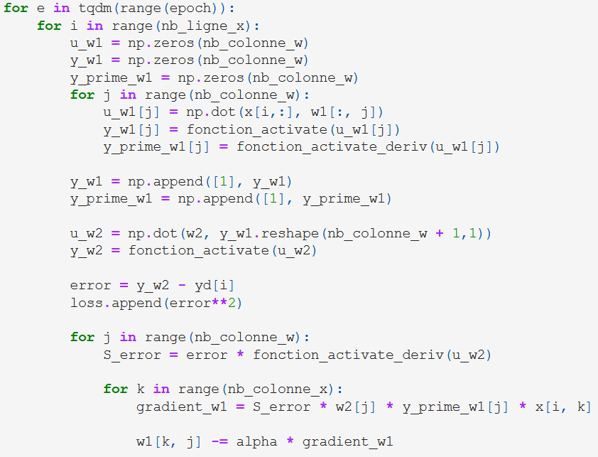
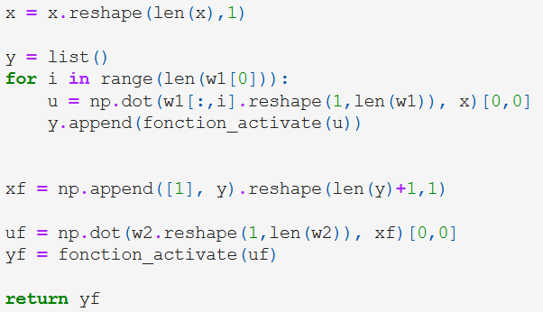
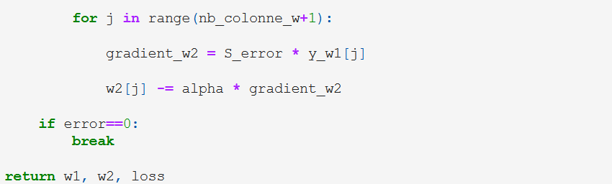
IV - Apprentissage Multicouches
Pour développer l’apprentissage multicouche, j’ai utilisé cette formule :
Notes:
Today, MESEA has around 200 employees, which can be divided into an operational and a functional branch.
The functional part concerns the production support activities, such as the Industrial Department, the Performance Department, the Quality, Safety and Environment Department etc.
----------------------------
The operational part is responsible of the line maintain, covering all the areas of a high-speed line.
In the world of railway maintenance, there are many different areas but we can reduce them to 4 major sectors: The track, the switch, the signalling and the energy.
The railway tracking is a runway for the trains. A train cannot driving on the road, that’s why the track allows to give a trajectory and a stability to the train.
The railway switching allows to give a direction to the train, to direct it, on one track or another.
The railway signalling can be defined as all the systems designed to control the train traffic in safety.

Slide 9
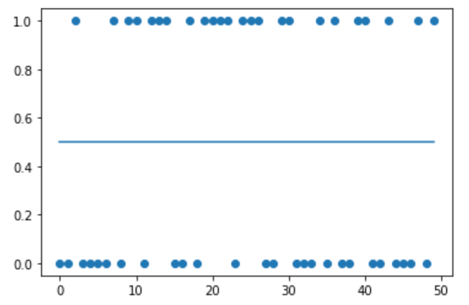
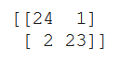
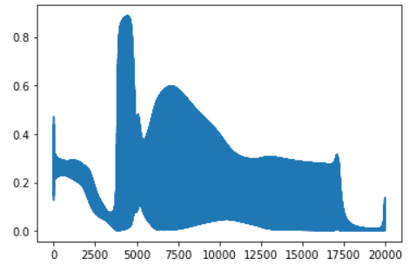
IV - Apprentissage Multicouches
Le graphique des prédictions
Les prédictions sont très bonnes
La matrice de confusion affiche un résultat quasiment parfait
En revanche la courbe d’erreur n’affiche pas une convergence nette vers 0
Après quelques tests avec des initialisations différentes, les résultats peuvent s’améliorer et présenter une belle convergence
et une fois relancé, peut grandement se détériorer
J’ai peut-être fait une erreur dans la fonction d’apprentissage mais je n’ai pas réussi à trouver où (malgré plusieurs heures de recherche)
Je n’ai donc pas fais la suite pour cette partie IV
La matrice de confusion
La courbe d’erreur
Notes:
Today, MESEA has around 200 employees, which can be divided into an operational and a functional branch.
The functional part concerns the production support activities, such as the Industrial Department, the Performance Department, the Quality, Safety and Environment Department etc.
----------------------------
The operational part is responsible of the line maintain, covering all the areas of a high-speed line.
In the world of railway maintenance, there are many different areas but we can reduce them to 4 major sectors: The track, the switch, the signalling and the energy.
The railway tracking is a runway for the trains. A train cannot driving on the road, that’s why the track allows to give a trajectory and a stability to the train.
The railway switching allows to give a direction to the train, to direct it, on one track or another.
The railway signalling can be defined as all the systems designed to control the train traffic in safety.

Slide 10
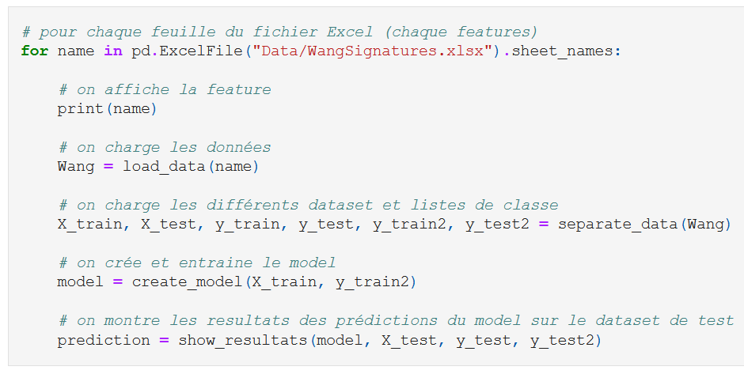
V - Volet Chargement des descripteurs
Pour charger les données, j’avais premièrement utilisé un dictionnaire,
mais j’ai finalement opté pour une boucle qui fera directement :
Le chargement des données
Le split des données
La création du modèle
La prédiction
L’affichage des résultats
Notes:
Today, MESEA has around 200 employees, which can be divided into an operational and a functional branch.
The functional part concerns the production support activities, such as the Industrial Department, the Performance Department, the Quality, Safety and Environment Department etc.
----------------------------
The operational part is responsible of the line maintain, covering all the areas of a high-speed line.
In the world of railway maintenance, there are many different areas but we can reduce them to 4 major sectors: The track, the switch, the signalling and the energy.
The railway tracking is a runway for the trains. A train cannot driving on the road, that’s why the track allows to give a trajectory and a stability to the train.
The railway switching allows to give a direction to the train, to direct it, on one track or another.
The railway signalling can be defined as all the systems designed to control the train traffic in safety.

Slide 11
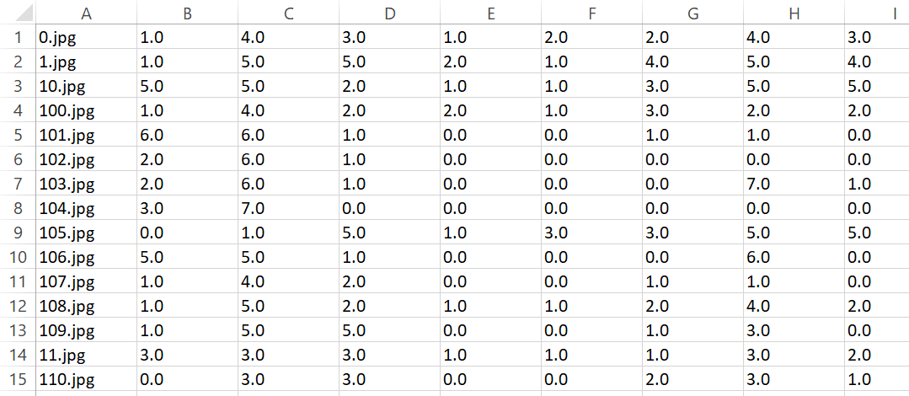
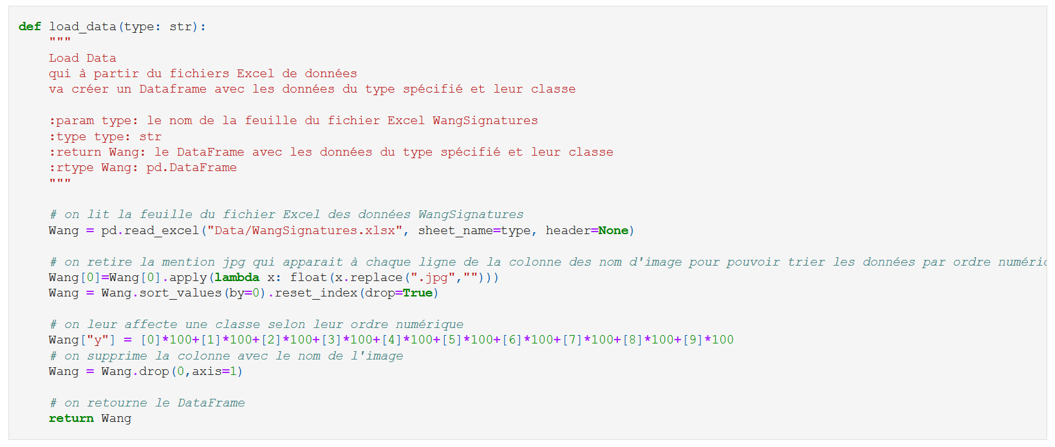
V - Volet Chargement des descripteurs - Chargement
Il fallait faire attention à l’ordre des données qui était faussé par les mention « .jpg » dans la 1ère colonne.
Ensuite on attribue les bonnes classes aux lignes de données
Notes:
Today, MESEA has around 200 employees, which can be divided into an operational and a functional branch.
The functional part concerns the production support activities, such as the Industrial Department, the Performance Department, the Quality, Safety and Environment Department etc.
----------------------------
The operational part is responsible of the line maintain, covering all the areas of a high-speed line.
In the world of railway maintenance, there are many different areas but we can reduce them to 4 major sectors: The track, the switch, the signalling and the energy.
The railway tracking is a runway for the trains. A train cannot driving on the road, that’s why the track allows to give a trajectory and a stability to the train.
The railway switching allows to give a direction to the train, to direct it, on one track or another.
The railway signalling can be defined as all the systems designed to control the train traffic in safety.

Slide 12
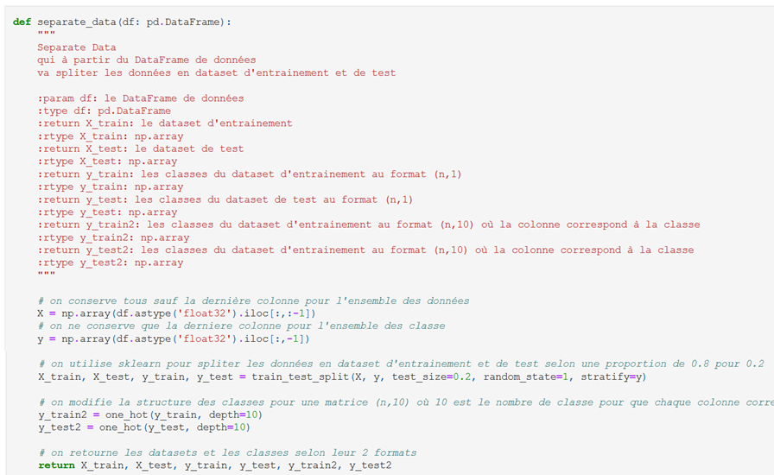
V - Volet Chargement des descripteurs - SPLIT
Il fallait faire attention à la « shape » des données de classe (y)
Par exemple on modifie le y_train qui est égal à « 3 » par une liste de 9 « 0 » et 1 « 1 » en position 3.
Pareil pour y_test.
3
[0,0,0,1,0,0,0,0,0,0]
Notes:
Today, MESEA has around 200 employees, which can be divided into an operational and a functional branch.
The functional part concerns the production support activities, such as the Industrial Department, the Performance Department, the Quality, Safety and Environment Department etc.
----------------------------
The operational part is responsible of the line maintain, covering all the areas of a high-speed line.
In the world of railway maintenance, there are many different areas but we can reduce them to 4 major sectors: The track, the switch, the signalling and the energy.
The railway tracking is a runway for the trains. A train cannot driving on the road, that’s why the track allows to give a trajectory and a stability to the train.
The railway switching allows to give a direction to the train, to direct it, on one track or another.
The railway signalling can be defined as all the systems designed to control the train traffic in safety.

Slide 13
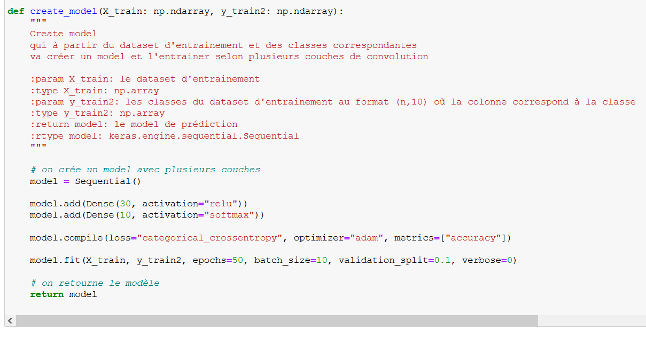
VI - Classification par Full Connected – 1ERe création
Pour une première approche autour de la création du modèle, j’ai fais le choix de 2 couches Dense :
1 de type « relu » avec 30 neurones
1 de type « softmax » avec 10 neurones (pour les 10 classes à prédire)
Pour la compilation, j’ai utilisé :
La fonction de perte « categorical_crossentropy » qui est souvent considérée comme la meilleure pour les classifications à plusieurs classes
L’optimiseur « Adam » pour s’appuyer sur le gradient stochastique
Notes:
Today, MESEA has around 200 employees, which can be divided into an operational and a functional branch.
The functional part concerns the production support activities, such as the Industrial Department, the Performance Department, the Quality, Safety and Environment Department etc.
----------------------------
The operational part is responsible of the line maintain, covering all the areas of a high-speed line.
In the world of railway maintenance, there are many different areas but we can reduce them to 4 major sectors: The track, the switch, the signalling and the energy.
The railway tracking is a runway for the trains. A train cannot driving on the road, that’s why the track allows to give a trajectory and a stability to the train.
The railway switching allows to give a direction to the train, to direct it, on one track or another.
The railway signalling can be defined as all the systems designed to control the train traffic in safety.

Slide 14
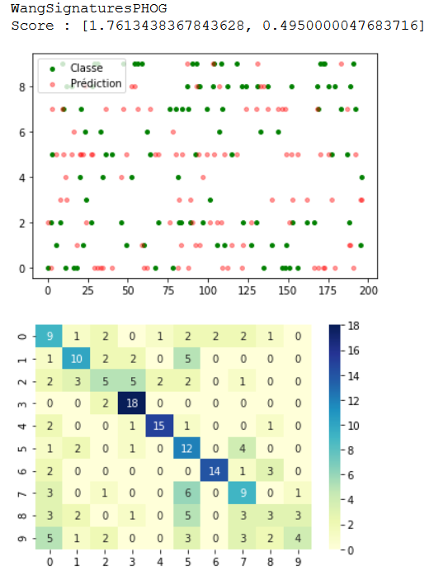
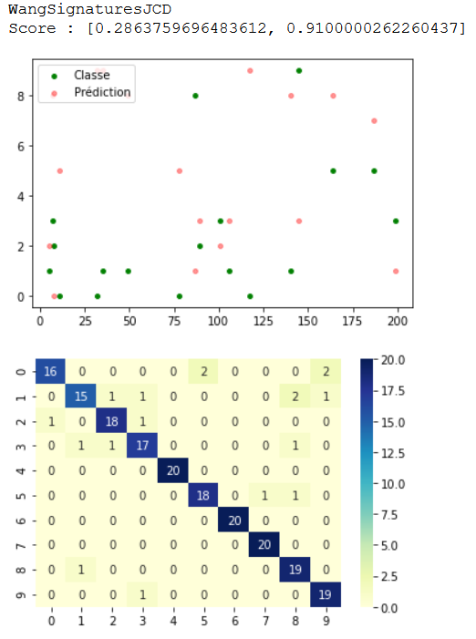
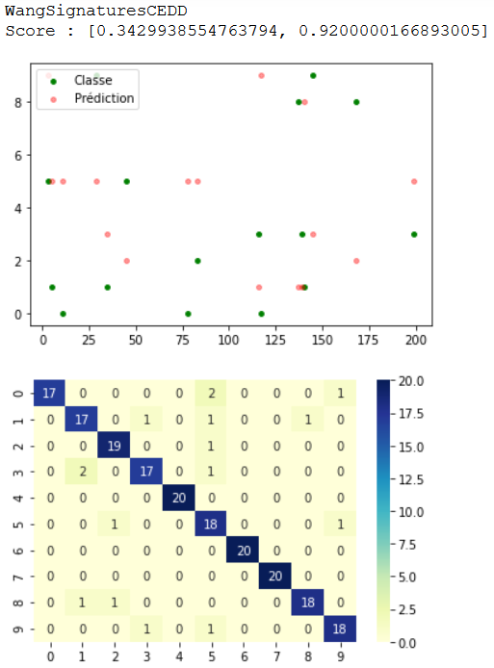
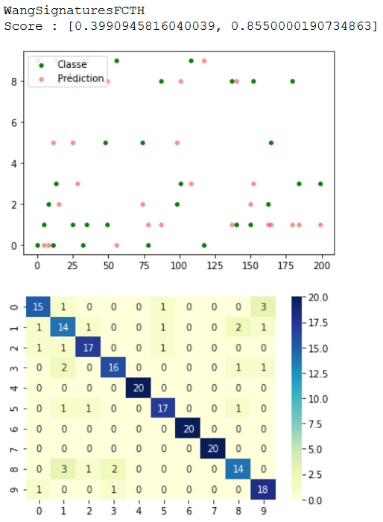
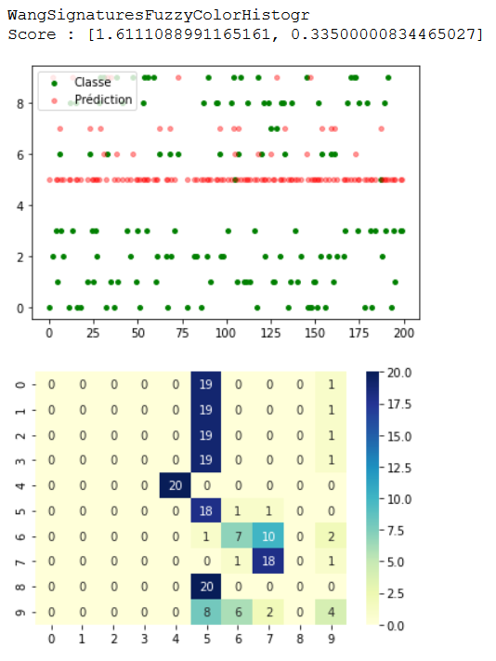
VI - Classification par Full Connected – 1^{ers} résultats
Pour les résultats, j’ai opté pour affiché sous forme de Score : [l’erreur, l’accuracy]
Puis un nuage de point qui représente :
En rouge, les classes mal prédites
En vert, leur vrai classe
Et enfin une matrice de confusion en utilisant la palette de couleur « YlGnBu »
Les résultats sont plutôt bons sur 3 ensembles de données sur 5 -> peut mieux faire
Notes:
Today, MESEA has around 200 employees, which can be divided into an operational and a functional branch.
The functional part concerns the production support activities, such as the Industrial Department, the Performance Department, the Quality, Safety and Environment Department etc.
----------------------------
The operational part is responsible of the line maintain, covering all the areas of a high-speed line.
In the world of railway maintenance, there are many different areas but we can reduce them to 4 major sectors: The track, the switch, the signalling and the energy.
The railway tracking is a runway for the trains. A train cannot driving on the road, that’s why the track allows to give a trajectory and a stability to the train.
The railway switching allows to give a direction to the train, to direct it, on one track or another.
The railway signalling can be defined as all the systems designed to control the train traffic in safety.

Slide 15
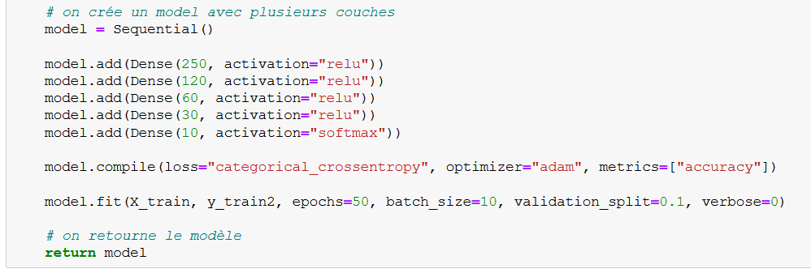
VI - Classification par Full Connected – Création
Après une dizaine de test en modifiant :
Le nombre de couche
Le nombre de neurone
Les fonctions d’activation
J’en ai ressorti comme conclusion que :
Plus il y avait de couches, mieux c’était
Le nombre de neurone pouvait faire passer les résultats de très bon à très mauvais
La fonction d’activation « relu » était très puissante
La dernière fonction d’activation devait être « softmax » pour obtenir les meilleurs résultats
J’ai donc fais le choix de 5 couches :
4 de type « relu » :
250 / 120 / 60 / 30 / 10 neurones
1 de type « softmax » :
10 neurones
Notes:
Today, MESEA has around 200 employees, which can be divided into an operational and a functional branch.
The functional part concerns the production support activities, such as the Industrial Department, the Performance Department, the Quality, Safety and Environment Department etc.
----------------------------
The operational part is responsible of the line maintain, covering all the areas of a high-speed line.
In the world of railway maintenance, there are many different areas but we can reduce them to 4 major sectors: The track, the switch, the signalling and the energy.
The railway tracking is a runway for the trains. A train cannot driving on the road, that’s why the track allows to give a trajectory and a stability to the train.
The railway switching allows to give a direction to the train, to direct it, on one track or another.
The railway signalling can be defined as all the systems designed to control the train traffic in safety.

Slide 16
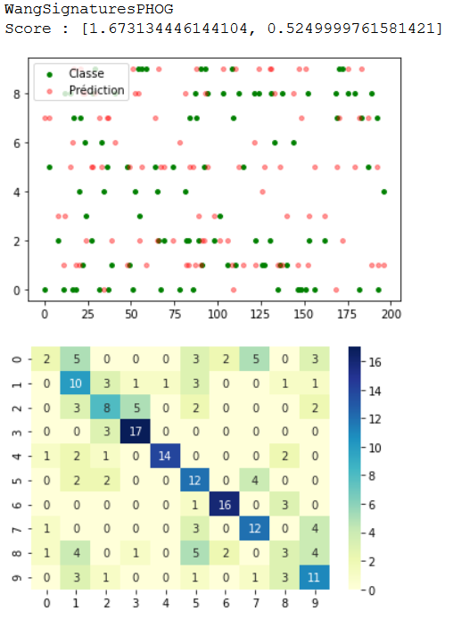
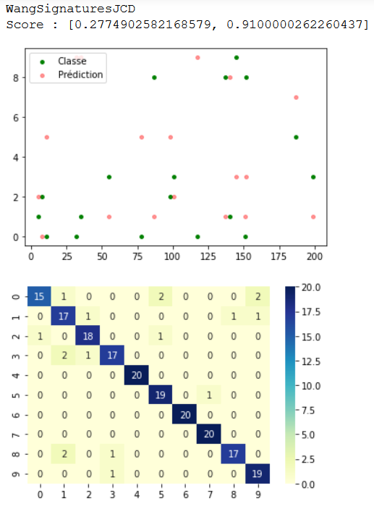
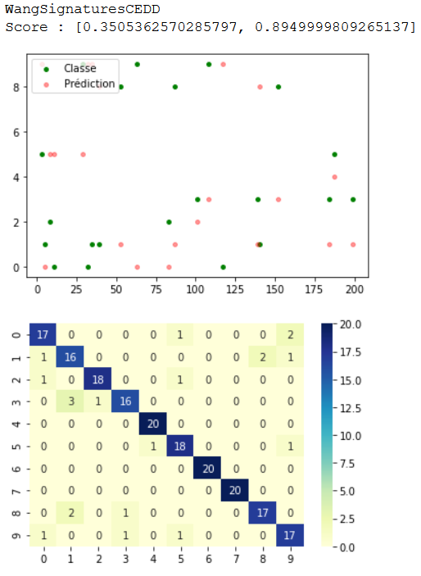
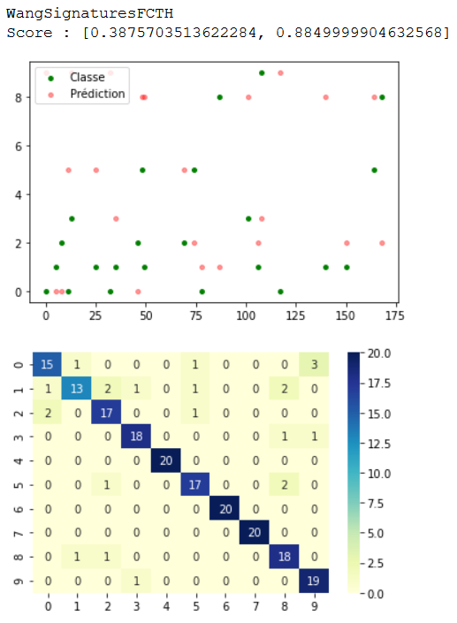
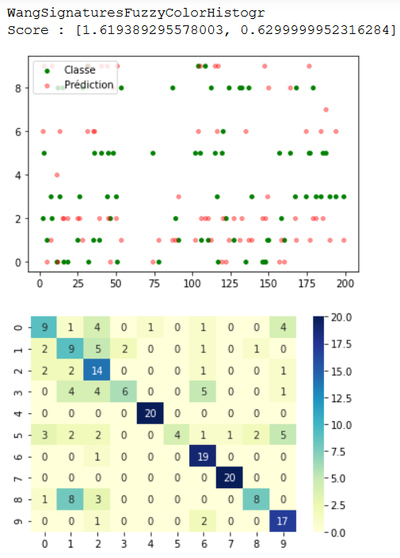
VI - Classification par Full Connected – résultats
Les résultats sont très bons pour les ensembles de données JCD/ CEDD/ FCTH
Les résultats des ensembles de données PHOG/ Fuzzy se sont améliorés -> peut encore mieux faire
Mais sur l’ensemble des données c’est le meilleur résultat que j’ai pu obtenir sans détériorer les uns des autres
Notes:
Today, MESEA has around 200 employees, which can be divided into an operational and a functional branch.
The functional part concerns the production support activities, such as the Industrial Department, the Performance Department, the Quality, Safety and Environment Department etc.
----------------------------
The operational part is responsible of the line maintain, covering all the areas of a high-speed line.
In the world of railway maintenance, there are many different areas but we can reduce them to 4 major sectors: The track, the switch, the signalling and the energy.
The railway tracking is a runway for the trains. A train cannot driving on the road, that’s why the track allows to give a trajectory and a stability to the train.
The railway switching allows to give a direction to the train, to direct it, on one track or another.
The railway signalling can be defined as all the systems designed to control the train traffic in safety.

Slide 17
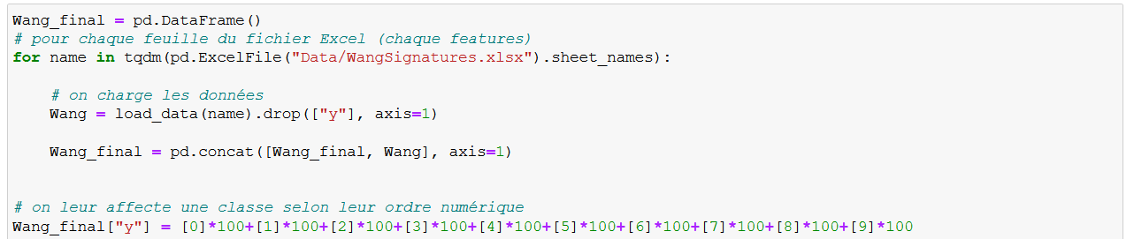
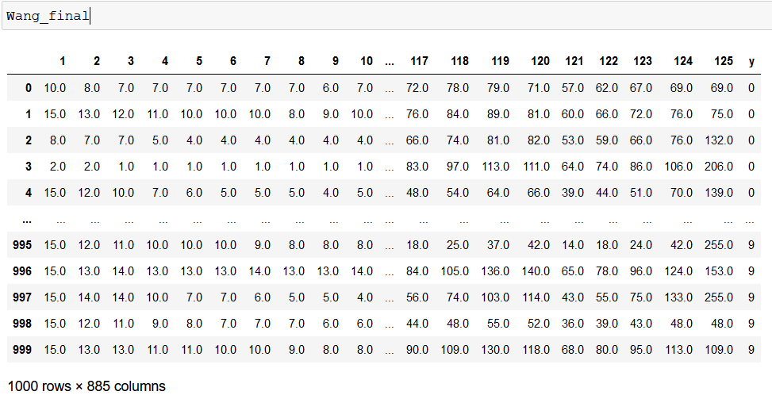
VI - Classification par Full Connected – Regroupement
Donc je me suis dit que si je n’arrivais pas à améliorer chacun des résultats sans détériorer les autres,
Il fallait que je regroupe toutes les données en 1 seul et unique ensemble de données :
On a bien 1000 lignes
et le 885 colonnes pour :
255 pour PHOG
168 pour JCD
144 pour CEDD
192 pour FCTH
125 pour Fuzzy
1 pour la classe
Notes:
Today, MESEA has around 200 employees, which can be divided into an operational and a functional branch.
The functional part concerns the production support activities, such as the Industrial Department, the Performance Department, the Quality, Safety and Environment Department etc.
----------------------------
The operational part is responsible of the line maintain, covering all the areas of a high-speed line.
In the world of railway maintenance, there are many different areas but we can reduce them to 4 major sectors: The track, the switch, the signalling and the energy.
The railway tracking is a runway for the trains. A train cannot driving on the road, that’s why the track allows to give a trajectory and a stability to the train.
The railway switching allows to give a direction to the train, to direct it, on one track or another.
The railway signalling can be defined as all the systems designed to control the train traffic in safety.

Slide 18
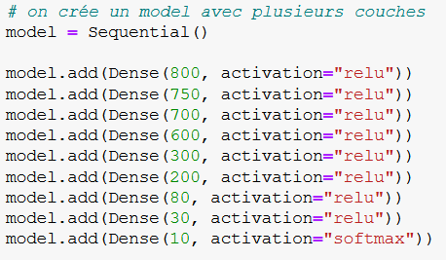
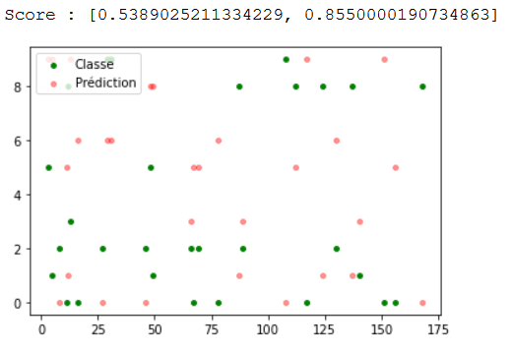
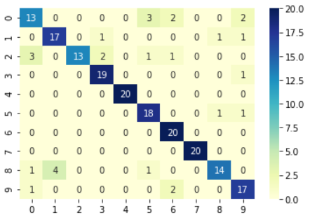
VI - Classification par Full Connected – résultats
J’ai donc utilisé mes conclusions précédentes pour créer mon super model de cette manière :
Et on arrive à un très bon résultats : 86 % en accuracy
Ce qui me satisfait parfaitement
Notes:
Today, MESEA has around 200 employees, which can be divided into an operational and a functional branch.
The functional part concerns the production support activities, such as the Industrial Department, the Performance Department, the Quality, Safety and Environment Department etc.
----------------------------
The operational part is responsible of the line maintain, covering all the areas of a high-speed line.
In the world of railway maintenance, there are many different areas but we can reduce them to 4 major sectors: The track, the switch, the signalling and the energy.
The railway tracking is a runway for the trains. A train cannot driving on the road, that’s why the track allows to give a trajectory and a stability to the train.
The railway switching allows to give a direction to the train, to direct it, on one track or another.
The railway signalling can be defined as all the systems designed to control the train traffic in safety.

Slide 19
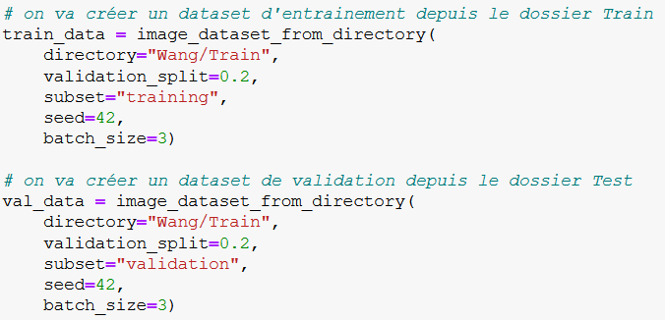
VII - Classification par DEEP – Chargement
Pour charger les images en 2 ensembles de données Train et Validation, j’ai utilisé la fonction :
Qui va aller :
Cibler un dossier
Lire les images pixel par pixel
Les transformer en liste ou chaque pixel est une liste de 3 valeurs (RGB)
Leur attribuer la classe qu'il convient
Splitter les données en ensemble Train et Validation
Notes:
Today, MESEA has around 200 employees, which can be divided into an operational and a functional branch.
The functional part concerns the production support activities, such as the Industrial Department, the Performance Department, the Quality, Safety and Environment Department etc.
----------------------------
The operational part is responsible of the line maintain, covering all the areas of a high-speed line.
In the world of railway maintenance, there are many different areas but we can reduce them to 4 major sectors: The track, the switch, the signalling and the energy.
The railway tracking is a runway for the trains. A train cannot driving on the road, that’s why the track allows to give a trajectory and a stability to the train.
The railway switching allows to give a direction to the train, to direct it, on one track or another.
The railway signalling can be defined as all the systems designed to control the train traffic in safety.

Slide 20
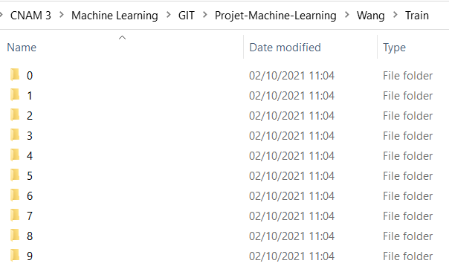
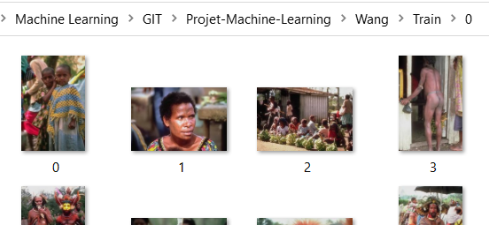
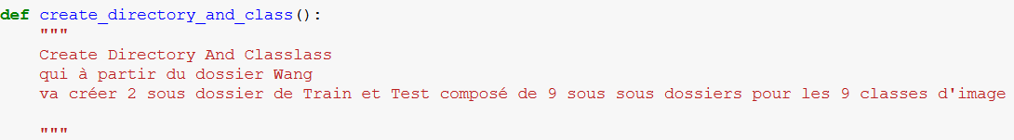
VII - Classification par DEEP – Chargement
Mais pour utiliser la fonction « image_dataset_from_directory », il fallait que le dossier soit dans un format très précis, chaque sous-dossier doit correspondre à la classe de l’image.
Donc j’ai créé la fonction « creat_directory_and_class » pour m’automatiser tout ça :
Notes:
Today, MESEA has around 200 employees, which can be divided into an operational and a functional branch.
The functional part concerns the production support activities, such as the Industrial Department, the Performance Department, the Quality, Safety and Environment Department etc.
----------------------------
The operational part is responsible of the line maintain, covering all the areas of a high-speed line.
In the world of railway maintenance, there are many different areas but we can reduce them to 4 major sectors: The track, the switch, the signalling and the energy.
The railway tracking is a runway for the trains. A train cannot driving on the road, that’s why the track allows to give a trajectory and a stability to the train.
The railway switching allows to give a direction to the train, to direct it, on one track or another.
The railway signalling can be defined as all the systems designed to control the train traffic in safety.

Slide 21


VII - Classification par DEEP – Split
On arrive donc à mettre en place nos jeux de donnée Train et Validation avec les 10 classes :
Où chaque image est
une liste de 256 listes de 3 valeurs
(256 pixels divisés en 3 valeurs RGB) :
…
Notes:
Today, MESEA has around 200 employees, which can be divided into an operational and a functional branch.
The functional part concerns the production support activities, such as the Industrial Department, the Performance Department, the Quality, Safety and Environment Department etc.
----------------------------
The operational part is responsible of the line maintain, covering all the areas of a high-speed line.
In the world of railway maintenance, there are many different areas but we can reduce them to 4 major sectors: The track, the switch, the signalling and the energy.
The railway tracking is a runway for the trains. A train cannot driving on the road, that’s why the track allows to give a trajectory and a stability to the train.
The railway switching allows to give a direction to the train, to direct it, on one track or another.
The railway signalling can be defined as all the systems designed to control the train traffic in safety.

Slide 22

VII - Classification par DEEP – Création
Pour cette création du modèle je mes suis aidé d’une chaine YouTube « Defend Intelligence » qui m’a proposé différents modèles, et c’est le suivant qui m’a apporté les meilleurs résultats :
En oubliant pas de mettre 10 neurones à la dernière couche (pour les 10 classes à prédire)
Et en rajoutant le dataset de Validation lors du « fit »
Notes:
Today, MESEA has around 200 employees, which can be divided into an operational and a functional branch.
The functional part concerns the production support activities, such as the Industrial Department, the Performance Department, the Quality, Safety and Environment Department etc.
----------------------------
The operational part is responsible of the line maintain, covering all the areas of a high-speed line.
In the world of railway maintenance, there are many different areas but we can reduce them to 4 major sectors: The track, the switch, the signalling and the energy.
The railway tracking is a runway for the trains. A train cannot driving on the road, that’s why the track allows to give a trajectory and a stability to the train.
The railway switching allows to give a direction to the train, to direct it, on one track or another.
The railway signalling can be defined as all the systems designed to control the train traffic in safety.

Slide 23


VII - Classification par DEEP – Résultats
Pour l’affichage, j’ai préféré laisser le « verbose » par défaut pour voir l’évolution de « l’accuracy ».
Et toujours ma matrice de confusion en utilisant la palette de couleur « YlGnBu »
On remarque que « l’accuracy » est déjà très bonne sur le dataset de Validation (95%),
mais également sur le dataset de Test (89%).
La matrice de confusion est vraiment très bonne, on constate que la 5ème classe (n°4, les éléphants) se prédit quasiment parfaitement, et pour les pires prédiction, le modèle se trompe moins d’1 fois sur 3.
Les résultats sont donc très satisfaisants.
Notes:
Today, MESEA has around 200 employees, which can be divided into an operational and a functional branch.
The functional part concerns the production support activities, such as the Industrial Department, the Performance Department, the Quality, Safety and Environment Department etc.
----------------------------
The operational part is responsible of the line maintain, covering all the areas of a high-speed line.
In the world of railway maintenance, there are many different areas but we can reduce them to 4 major sectors: The track, the switch, the signalling and the energy.
The railway tracking is a runway for the trains. A train cannot driving on the road, that’s why the track allows to give a trajectory and a stability to the train.
The railway switching allows to give a direction to the train, to direct it, on one track or another.
The railway signalling can be defined as all the systems designed to control the train traffic in safety.

Slide 24



VII - Classification par DEEP – Data augmentation
Pour cette partie j'ai utilisé une extension de Mozilla Firefox « Download All Image »
Cette extension permet de sauvegarder, via Google Images, environ 50 images de chaque classe,
Pour les mettre dans le sous-dossier Test du dossier Wang
Notes:
Today, MESEA has around 200 employees, which can be divided into an operational and a functional branch.
The functional part concerns the production support activities, such as the Industrial Department, the Performance Department, the Quality, Safety and Environment Department etc.
----------------------------
The operational part is responsible of the line maintain, covering all the areas of a high-speed line.
In the world of railway maintenance, there are many different areas but we can reduce them to 4 major sectors: The track, the switch, the signalling and the energy.
The railway tracking is a runway for the trains. A train cannot driving on the road, that’s why the track allows to give a trajectory and a stability to the train.
The railway switching allows to give a direction to the train, to direct it, on one track or another.
The railway signalling can be defined as all the systems designed to control the train traffic in safety.

Slide 25

VII - Classification par DEEP – Data augmentation
En utilisant donc les images de Test téléchargées en masse d’internet, on obtient ces résultats :
Malheureusement les prédictions ne sont pas bonnes car les images d'internet ne sont pas toutes ressemblantes à nos images d'entrainement.
Il faudrait prendre plus de temps pour bien sélectionner uniquement les images qui pourraient être reconnues.
Ou alors augmenter nos échantillons d'apprentissage…
Notes:
Today, MESEA has around 200 employees, which can be divided into an operational and a functional branch.
The functional part concerns the production support activities, such as the Industrial Department, the Performance Department, the Quality, Safety and Environment Department etc.
----------------------------
The operational part is responsible of the line maintain, covering all the areas of a high-speed line.
In the world of railway maintenance, there are many different areas but we can reduce them to 4 major sectors: The track, the switch, the signalling and the energy.
The railway tracking is a runway for the trains. A train cannot driving on the road, that’s why the track allows to give a trajectory and a stability to the train.
The railway switching allows to give a direction to the train, to direct it, on one track or another.
The railway signalling can be defined as all the systems designed to control the train traffic in safety.

Slide 26
Merci de votre attention
Notes:
les mesures de la tension résiduel des rails qui sont en mVeff

